Slide 1

Toska consultants
2
+
2
+
Ending the Silence
Notes:
Identifying opportunities
Pursuing truth
Extracting the signal
Silencing the noise
Data to signal
Noise to signal
Unearthing America’s voice
Ending the Silence

Slide 2
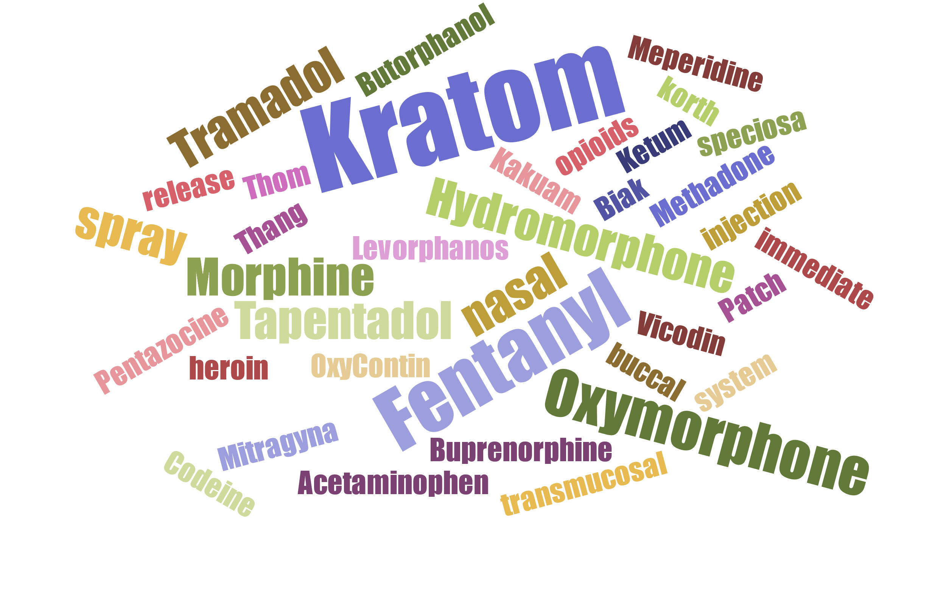

Slide 3
Teams
Analysis Team
  Analyzed Medicare Part D Opioid Prescriber Summary File 2016
    https://data.cms.gov/Medicare-Part-D/Medicare-Part-D-Opioid-Prescriber-Summary-File-201/6wg9-kwip/data
  Analyzed Twitter feed for sentiment analysis.
    Key words include: Kratom, Opioids
Extraction Team
  Convert JSON into human readable format (CSV)
  Extracted the following information:
    Submitter: yes/no
    Title
    Post It Date
    Docket ID

Slide 4
Teams
Research Team
  Identified states that have banned Kratom
  Compiled FDA data on current
Data Visualization Team
  Created Word Cloud

Slide 5
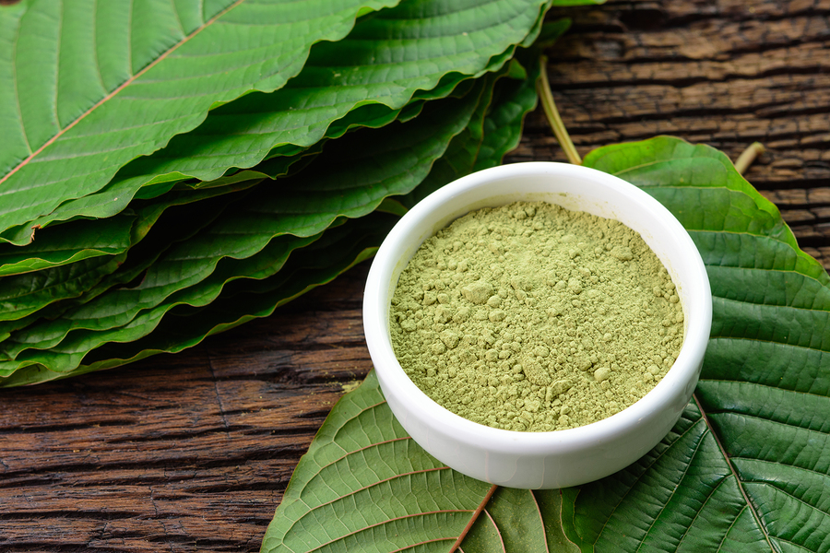
Kratom is an over the counter herbal supplement.
We analyzed sentiment, Medicare FFS claims data, and user analysis to determine consumer’s attitudes on opioids and Kratom.
Our goal is to identify public sentiment on Kratom as an alternative to prescription opioids.
Long-term, we will utilize findings to assist with an awareness campaign to help lobbying efforts

Slide 6
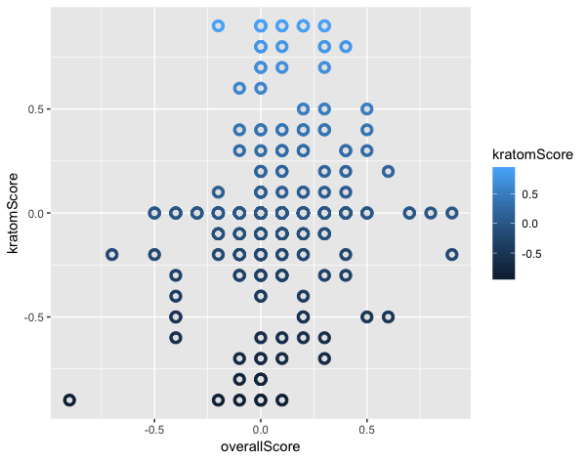
Sentiment Score from KratoM
DEA data set

Slide 7
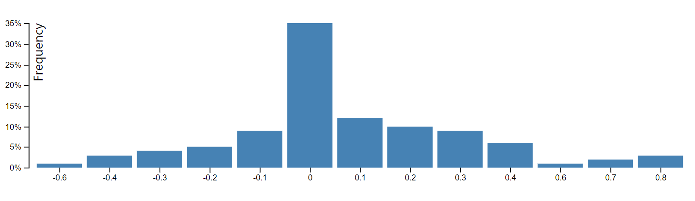
Sentiment Score from KratoM
DEA data set

Slide 8
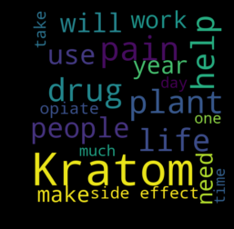
Sentiment Score from Kratom
DEA data set

Slide 9
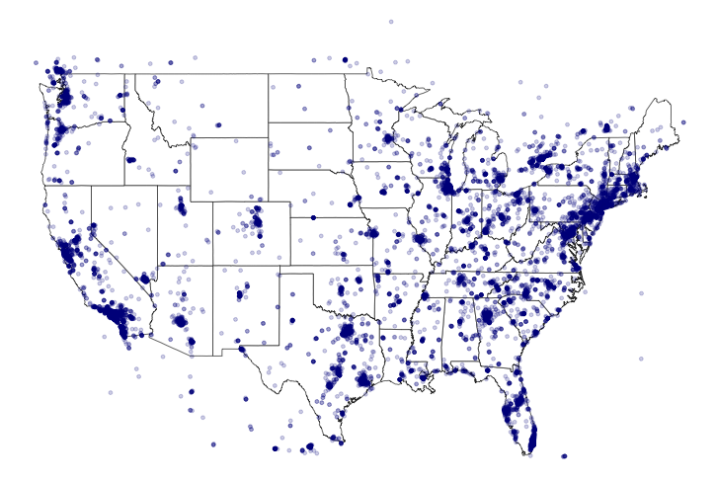
Twitter sentiment analysis
Notes:
Here is the tweets map in the US in the last few hours. The key words are: “kratom”,‘Thang’,‘Kakuam’,‘Thom’,‘Ketum’,‘Biak’,‘Mitragyna speciosa korth’,‘OxyContin’, ‘Vicodin’,‘heroin’,‘opioids’,‘fentanyl’,‘morphine’, ‘Buprenorphine’,‘Fentanyl Patch’,‘Hydromorphone’,‘Levorphanos’,‘Oxymorphone’, ‘Oxymorphone’,‘Tapentadol’,‘Methadone’,‘Tramadol’,‘Butorphanol nasal spray’, ‘Codeine’,‘Fentanyl buccal’,‘Fentanyl injection’,‘Fentanyl nasal spray’,‘Fentanyl transmucosal system’,‘Hydromorphone’,‘Meperidine’,‘Morphine immediate release’,‘Oxymorphone’,‘Pentazocine + Acetaminophen’,‘Tapentadol’,‘Tramadol’

Slide 10
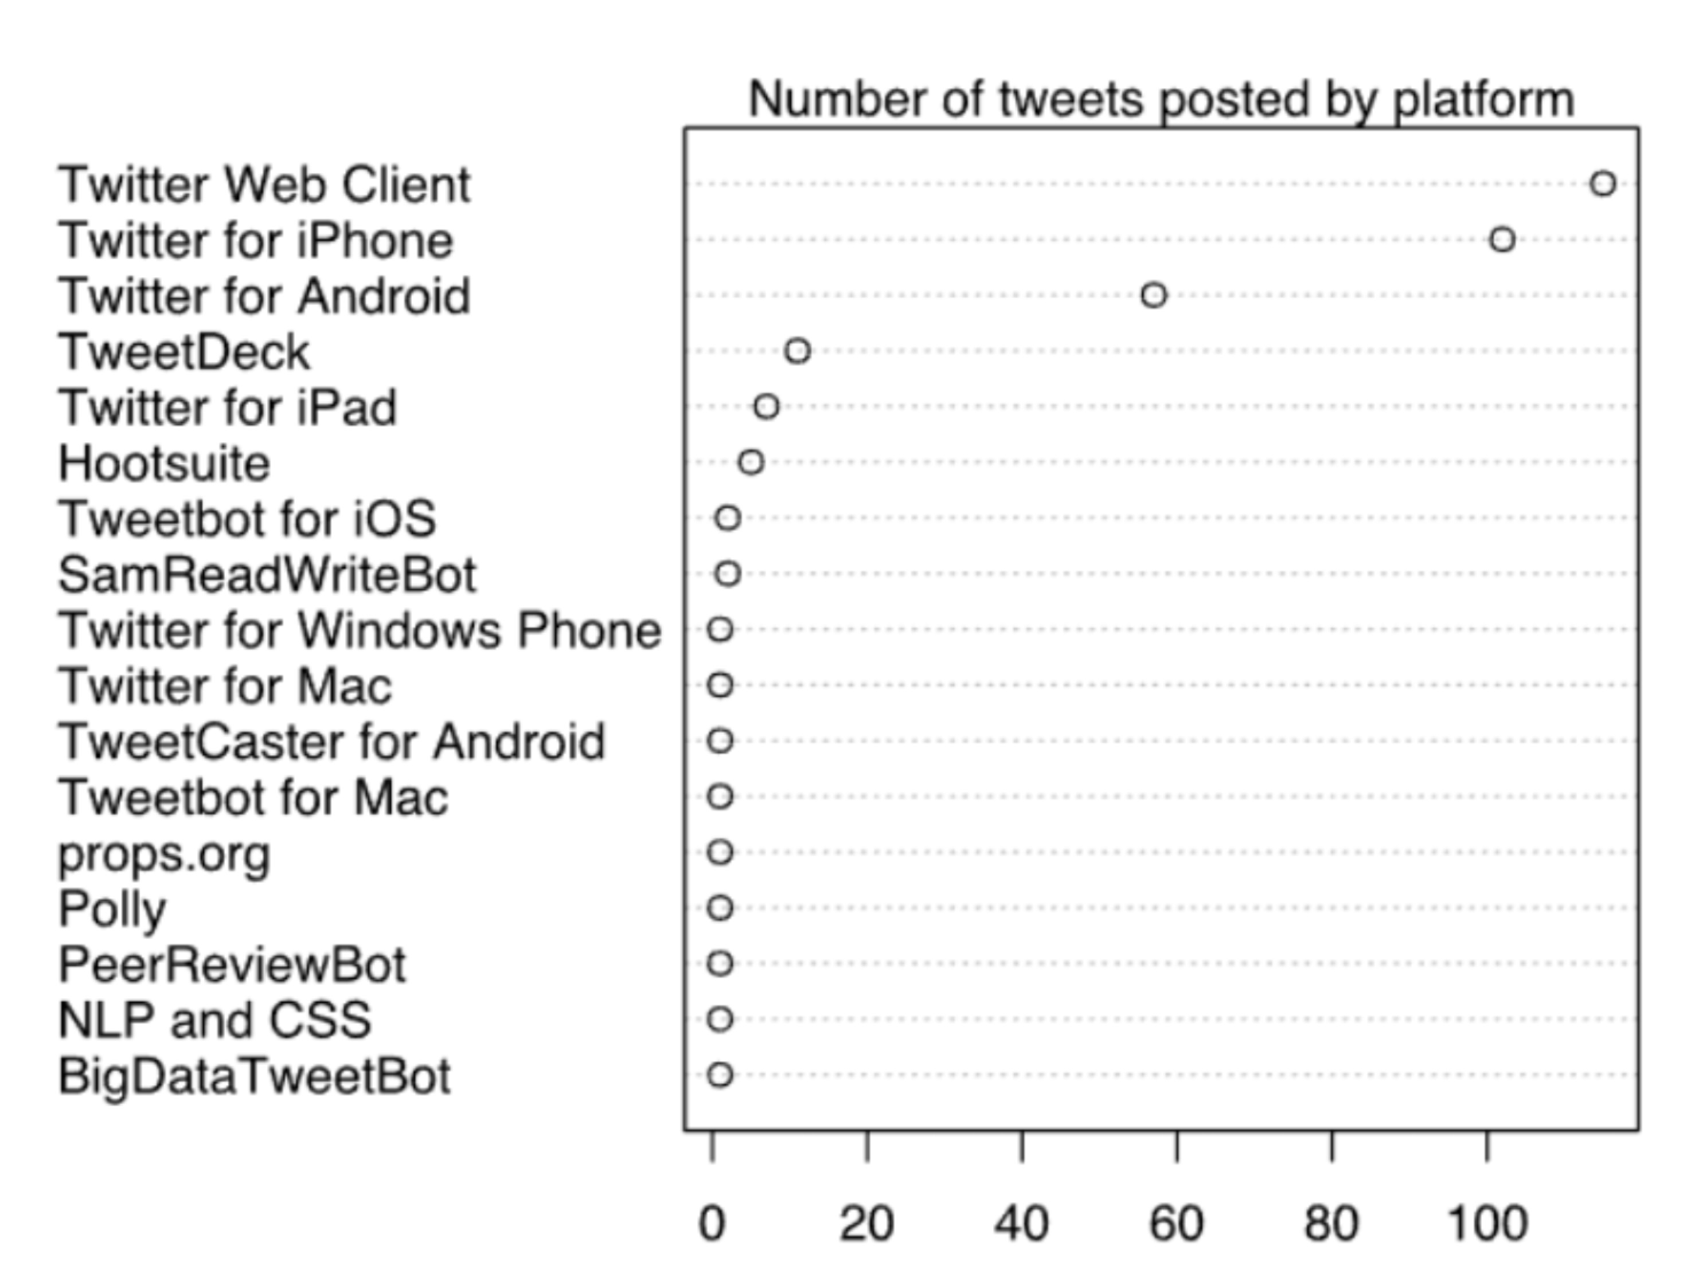
Twitter sentiment analysis

Slide 11
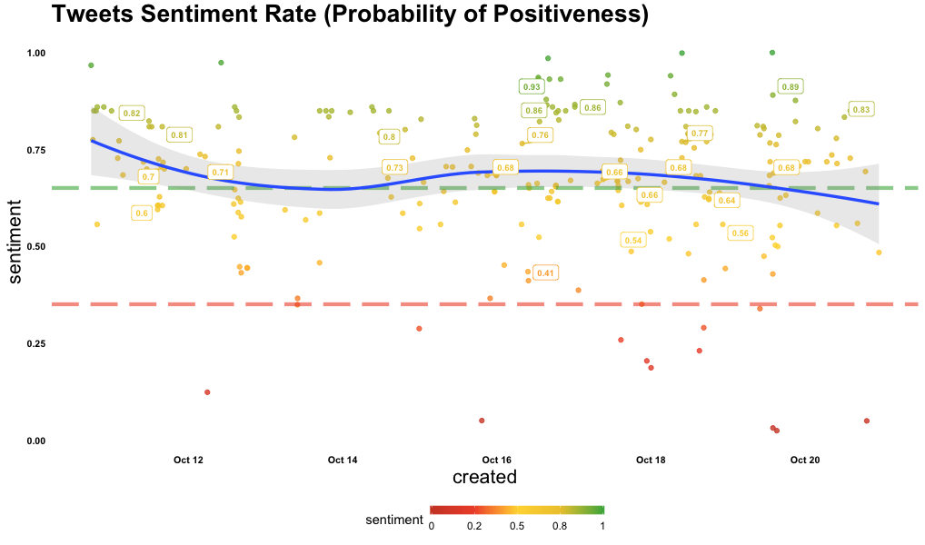
Twitter sentiment analysis

Slide 12
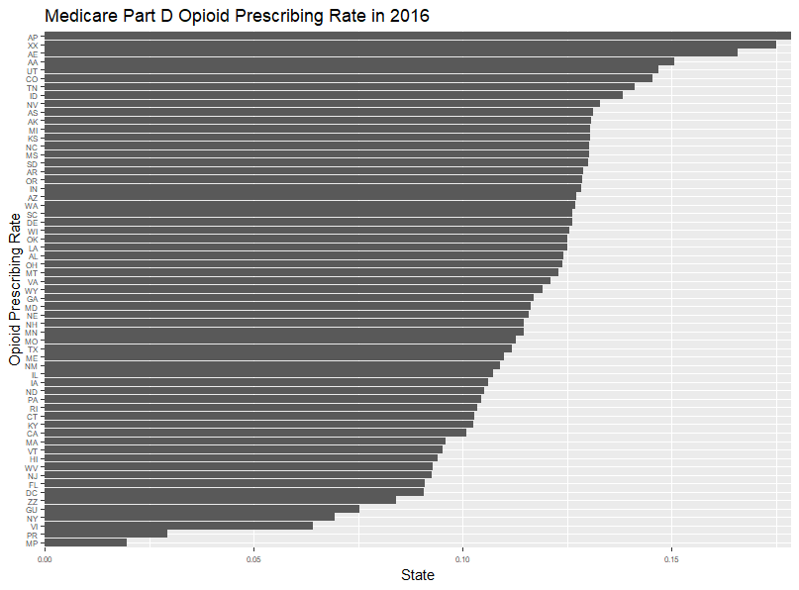
Medicare ffs analysis
There are total 1,131,550 NPIs in 2016 Medicare Part D data, where there are 500,435 total NPIs who prescribed opioid in 2016.

Slide 13
Medicare ffs analysis
Zip codes tied to a Military bases (AP) had the largest opioid prescribing rate in 2016; Another Military Base (MP)area has the lowest rate.

Slide 14
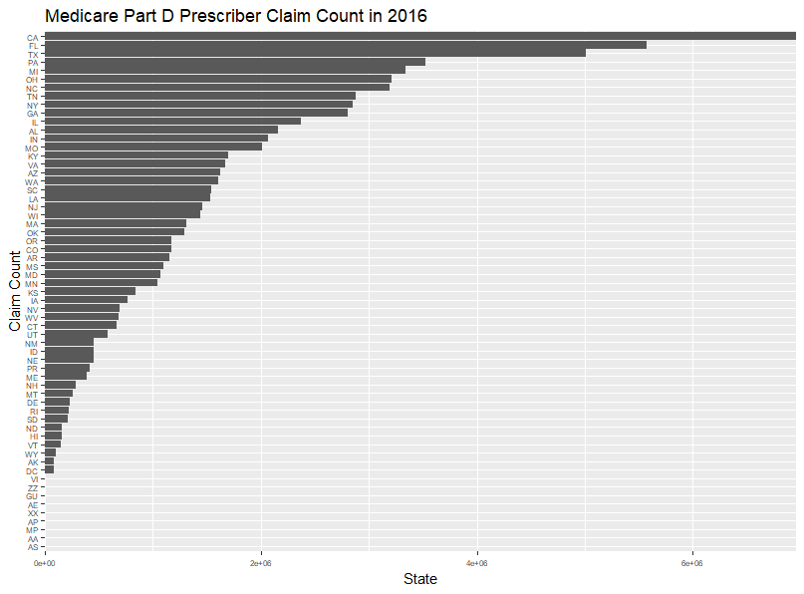
Medicare ffs analysis
CA has the largest total claim count, however, CA is not a dominant opioid state. The correlation between total claim count per NPI and opioid claim count in 2016 is 0.4846799. The low correlation indicates that total claims and opioid claims are not highly correlated.

Slide 15
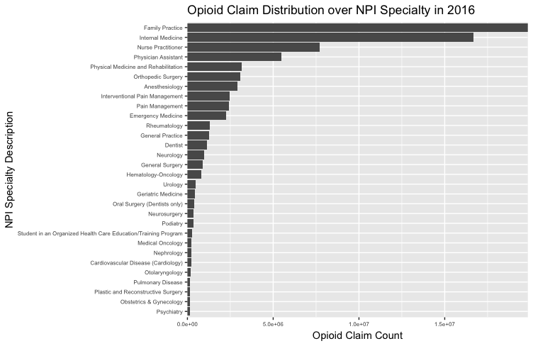
Medicare ffs analysis
It’s the opioid claim distribution over NPI specialties, which indicates that most of the opioid claims were prescribed by family practice and internal Medicare in 2016.

Slide 16
Fda information
The FDA has voiced concerned on the potential for abuse, addiction and adverse drug events. “This is why the FDA developed the Public Health Assessment via Structural Evaluation (PHASE) methodology – a tool to help us simulate, using 3-D computer technology, how the chemical constituents of a substance (such as the compounds/alkaloids found in kratom) are structured at a molecular level, how they may behave inside the body, and how they can potentially affect the brain.”
44 reported deaths to date

Slide 17
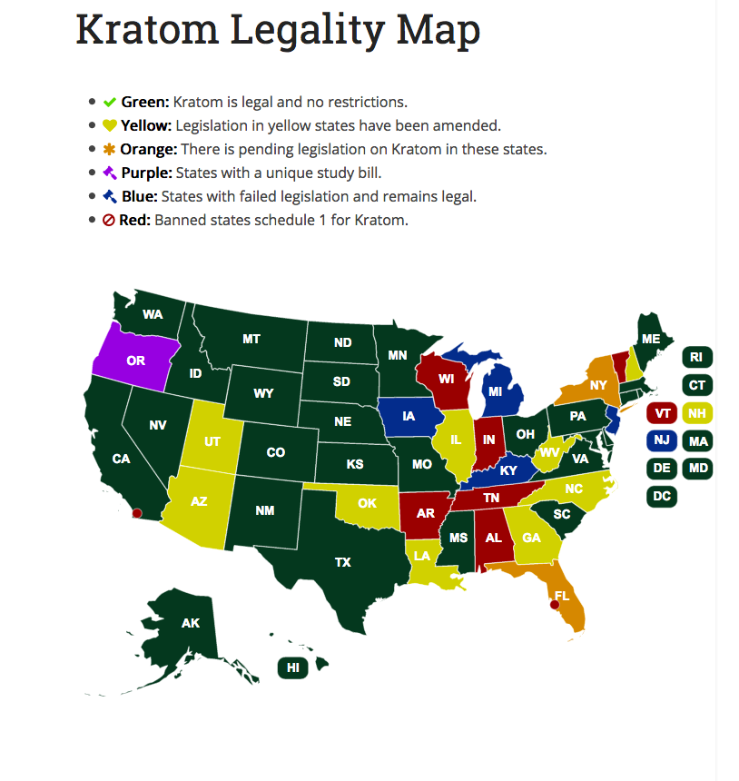
Passage of HB 4106 would make Illinois one of seven states with a statewide ban on kratom, according to the Pew Charitable Trusts. The other six states with a wholesale ban on the substance are Alabama, Vermont, Tennessee, Wisconsin, Indiana and Arkansas. Washington, D.C., also bans kratom.

Slide 18
“Hello, thank you for allowing me to tell you about my experience with Kratom. I am 48 years old, a single dad.
I have been taking kratom now for 4 years. My quality of life has changed so much for the better since I started using Kratom. Kratom helps me with my pain, energy and focus. I work 2 jobs and I am raising my son on my own. Before Kratom I would be tired constantly and would barely have the energy to do any thing. I have not and will not take any prescription drugs for pain or depression. I find Kratom to work wonders and its natural and safe. I lost my wife to prescription pain and antidepressant meds almost 3 years ago and I know the damage they cause first hand. I only wish I had found Kratom earlier and maybe my son will have his mom here with us today.
Please keep Kratom available for the many people who depend on it. I understand regulating it so people under 18 cant purchase it. Thank you again for your time and please understand this is doing so much more good than bad.”
Notes:
Public sentiment was analyzed to understand public sentiment of kratom and prescription opioids
Medicare claims data was analyzed to understand the impact of prescription opioids- an annual $75 billion dollar economic impact
Short term goal: An awareness campaign to bring a voice to those suffering in silence. Addiction is
Long term: utilize our findings to help others push legislative action in favor of or against Kratom

Slide 19
THANK YOU
2
+
2
+
Anthony Tang, Amy Jin, Chandra Karanam, Eric Bakota, Eric Chiu, Shreya Chandrasekar, and Vanessa Andow

